Slide 1
2. Boolean Algebra and Logic Gates

Slide 2
Outline
Review: Duality Principle
Design
Min term & Sum of Product
Max Term & Product of SUM
Boolean function: Representation, Canonical form
Mores gates: XOR,XNOR, NAND, NOR

Slide 3
Principle of Duality
Dual of a statement S is obtained Principle of Duality
By interchanging * and +
By interchanging interchanging 0 and 1
Dual of (a*1)*(0+a’) = 0 is (a+0)+(1*a’) = 1

Slide 4
Boolean Functions:Terminology
F(a,b,c) = a’bc + abc’ + ab + c
Variable
Represents a value (0 or 1), Three variables: a, b, and c
Literal
Appearance of a variable, in true or complemented form
Nine literals: a’, b, c, a, b, c’, a, b, and c
Product term
Product of literals, Four product terms: a’bc, abc’, ab, c

Slide 5
Representations of Boolean Functions
English 1: F outputs 1 when a is 0 and b is 0, or when a is 0 and b is 1.
English 2: F outputs 1 when a is 0, regardless of b’s value
Equation 1: F(a,b) = a’b’ + a’b
Equation 2: F(a,b) = a’

Slide 6
Boolean Algebra and Logic Gates
Basic Definitions
1. Closure : A set S is closed with respect to a binary operator if, for every pair of elements of S, the binary operator specifies a rule for obtaining a unique elements of S.
2. Associative law : (x*y)*z=x*(y*z) for all x,y,z∈S
3. Commutative law : x*y=y*x for all x,y∈S
4. Identity elements: for all x∈S, e*x=x*e=x
ex) set of integers I={…, -3, -2, -1, 0, 1, 2, 3, …}, x+0=0+x=x
5. Inverse : A set S having the identity elements
(Boolean algebra does not have +,* inverse)
for all x∈S , y∈S, x*y=e
6. Distributive law : x*(y+z)=(x*y) + (x*z)
x+(y*z)=(x+y) * (x+z)
Boolean algebra is an algebra that deals with binary variables and
logic operations
Boolean function described by algebraic expression using binary
variable & logic operation

Slide 7
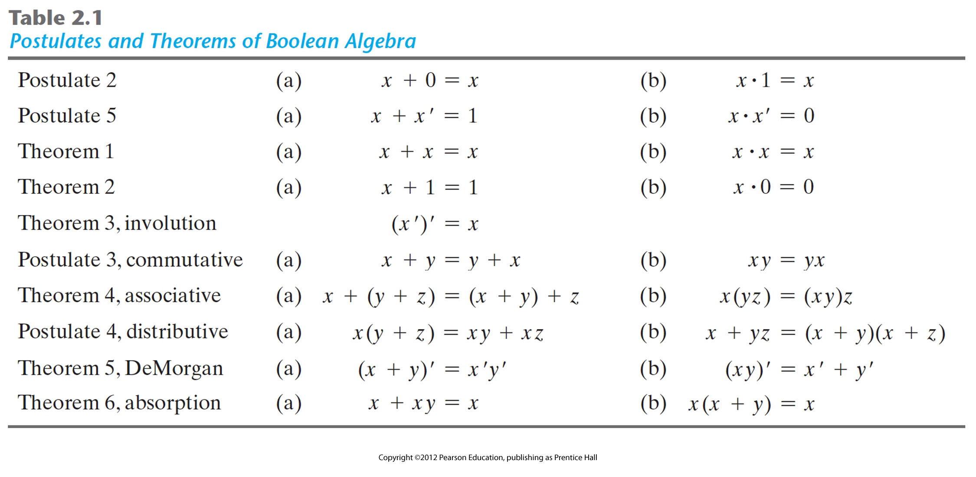
Basic Theorems and Properties of Boolean Algebra
dual
Consensus (a) xy+x'z+yz = xy+x'z (b) (x+y)(x'+z)(y+z) =(x+y)(x'+z)
∪ = or = + , ∩ = and = *
1 = 전체 집합, 0 = 공집합
x + x`을 곱하거나, x*x1을 더해서 식을 간략화 한다.

Slide 8
Representation Conversion
Need to transition between boolean expression, truth table, and circuit (symbols).
Converting between truth table and expression is easy.
Converting between expression and circuit is easy.
More difficult to convert to truth table.
Boolean
Expression
Circuit
Truth
Table

Slide 9
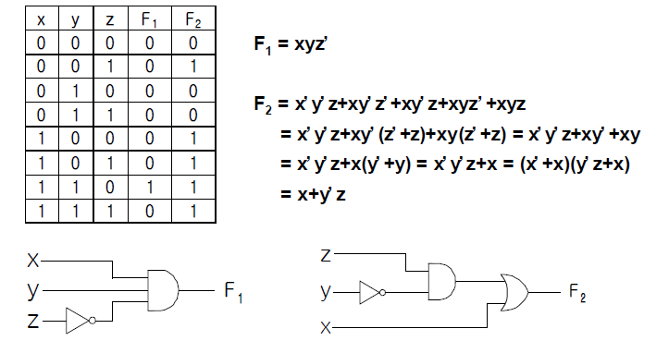
Boolean function
Operator precedence
1. Parentheses 2. NOT (’) 3. AND (•) 4. OR (+)
Boolean function

Slide 10
Boolean Functions – Algebraic Manipulation
Ex 2-1) Simplify the following Boolean functions to a minimum number of literals.
1. x(x'+y) = xx' + xy = 0 + xy = xy.
2. x +x'y = (x+x')(x+y) = 1(x+y) = x + y.
3. (x+y)(x+y') = x + xy + xy' + yy' = x(1+y+y') = x.
4. xy + x'z + yz = xy + x'z + yz(x+x')
= xy + x'z + xyz + x'yz
= xy(1+z) + x'z(1+y)
= xy + x'z
5. (x+y)(x'+z)(y+z) = (x+y)(x'+z) : by duality from function 4.
(A + B + C)'= (A+x)' let B+C=x
= A'x' by theorem 5(a)(DeMorgan)
= A'(B+C)' substitute B+C=x
= A'(B'C') by theorem 5(a)(DeMorgan)
= A'B'C' by theorem 4(b)(associative)
=> (A+B+C+D+…+F)' = A'B'C'D'…F'
(ABCD…F)' = A' +B'+ C' + D' + … + F'

Slide 11
Boolean Functions – Complement of a Function
Complement of a variable x is x’ (0⇒ 1 and 1⇒ 0)
The complement of a function F is F’ and is obtained from an interchange of 0’s for 1’s and 1’s for 0’s in the value of F
The dual of a function is obtained from the interchange of AND and OR operators and 1’s and 0’s
Finding the complement of a function F
1. Applying DeMorgan’s theorem as many times as necessary
2. complementing each literal of the dual of F

Slide 12
Boolean Functions – Complement of a Function
Ex 2-2) Find the complement of the functions
F₁=x'yz'+x'y'z, F₂=x(y'z'+yz).
F₁' = (x'yz'+x'y'z)' = (x'yz')'(x'y'z)' = (x+y'+z)(x+y+z')
F₂' = [x(y'z'+yz)]' = x'+(y'z'+yz)' = x'+(y'z')'(yz)'
= x'+(y+z)(y'+z')
Ex 2-3) Find the complement of the functions F₁ And F₂ Ex 2-2 by taking their duals and complementing each literal.
1. F₁ = x'yz' + x'y'z.
The dual of F₁ is (x'+y+z')(x'+y'+z)
Complement each literal : (x+y'+z)(x+y+z')=F₁'
2. F₂ = x(y'z'+yz).
The dual of F₂ is x+(y'+z')(y+z)이다.
Complement each literal : x'+(y+z)(y'+z')=F₂'

Slide 13
Canonical Form ‐‐ Sum of Minterms
Truth tables too big for numerous inputs
Use standard form of equation instead
Known as canonical form
Regular algebra: group terms of polynomial by power
ax² + bx + c (3x² + 4x + 2x² + 3 + 1 ‐‐> 5x² + 4x + 4)
Boolean algebra: create sum of minterms
Minterm: product term with every function literal appearing exactly once, in normal (i.e., x) or complemented form (i.e., x’)
Just multiply‐out equation until sum of product terms
Then expand each term until all terms are minterms
Determine if F(a,b)=ab+a’ is same function as F(a,b) = a’ b ’+a’b+ab by canonical form.
F = ab+a’ (already sum of products)
F = ab + a’(b+b’) (expanding term)
F = ab + a’b + a’b’ (it is canonical form)

Slide 14
Canonical Form or Standard Form
Canonical forms
Sum of minterms (SOM)
Product of maxterms (POM)
Standard forms (may use less gates) → “회로 간략화＂
Sum of products (SOP)
Product of sums (POS)

Slide 15
Minterms (standard product) → 곱이 항상 1
product term is a term where literals are ANDed.
Example: x’y’, xz, xyz, …
Boolean variables can appear in normal (x) or complement form (x’)
Minterm : A product term in which all variables appear exactly once, in normal or complemented form
A minterm equals 1 at exactly one input combination and is equal to 0 otherwise
Each AND combination of terms is a minterm
A minterm is denoted as m_{i} where i corresponds the input combination at which this minterm is equal to 1

Slide 16
Maxterms (standard sum) → 합이 항상 0
Sum term is a term where literals are ORed.
Example: x’+y’, x+z, x+y+z, …
Boolean variables can appear in normal (x) or complement form (x’)
Maxterm : A sum term in which all variables appear exactly once, in normal or complemented form
A maxterm equals 0 at exactly one input combination and is equal to 1 otherwise
Each OR combination of terms is a maxterm
A maxterm is denoted as M_{i} where i corresponds the input combination at which this minterm is equal to 0

Slide 17
Minterms and Maxterms
Two variable minterms and maxterms.
• The index above is important for describing which variables in the terms are true and which are complemented.
index | Minterm | Maxterm
0 | x’ y’ | x+ y
1 | x’ y | x+ y’
2 | x y’ | x’+ y
3 | x y | x’+ y’

Slide 18
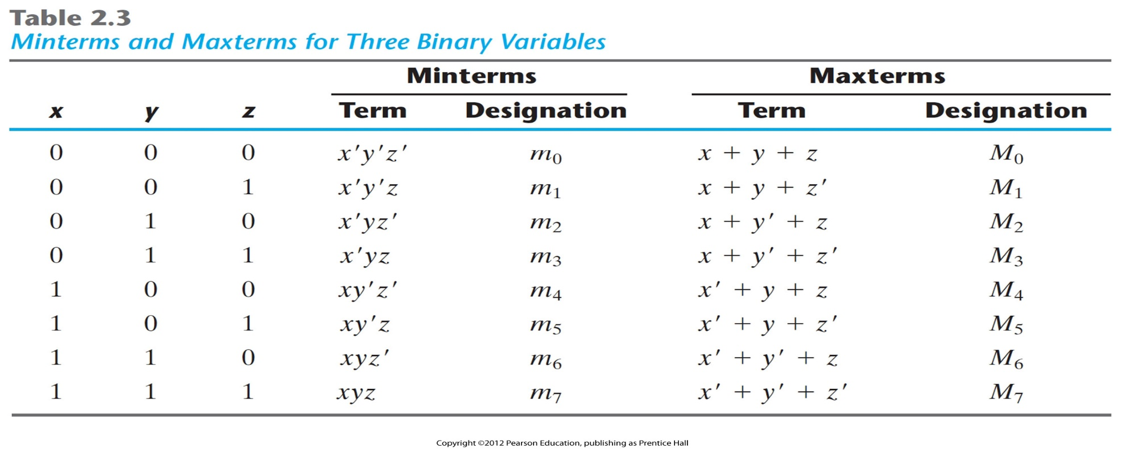
Canonical and Standard Forms
complement

Slide 19
Expressing Functions
Boolean function can be expressed algebraically from a give truth table
minterm & maxterm은 truth table에서 쉽게 얻을 수 있다.
function can be expressed algebraically as:
The sum of minterms
The product of maxterms
With Minterm
∑m_{i}-For all the minterms that produce 1 in the function in the function
With Maxterm
ΠM_{i}-For all the maxterms that produce 0 in the function

Slide 20
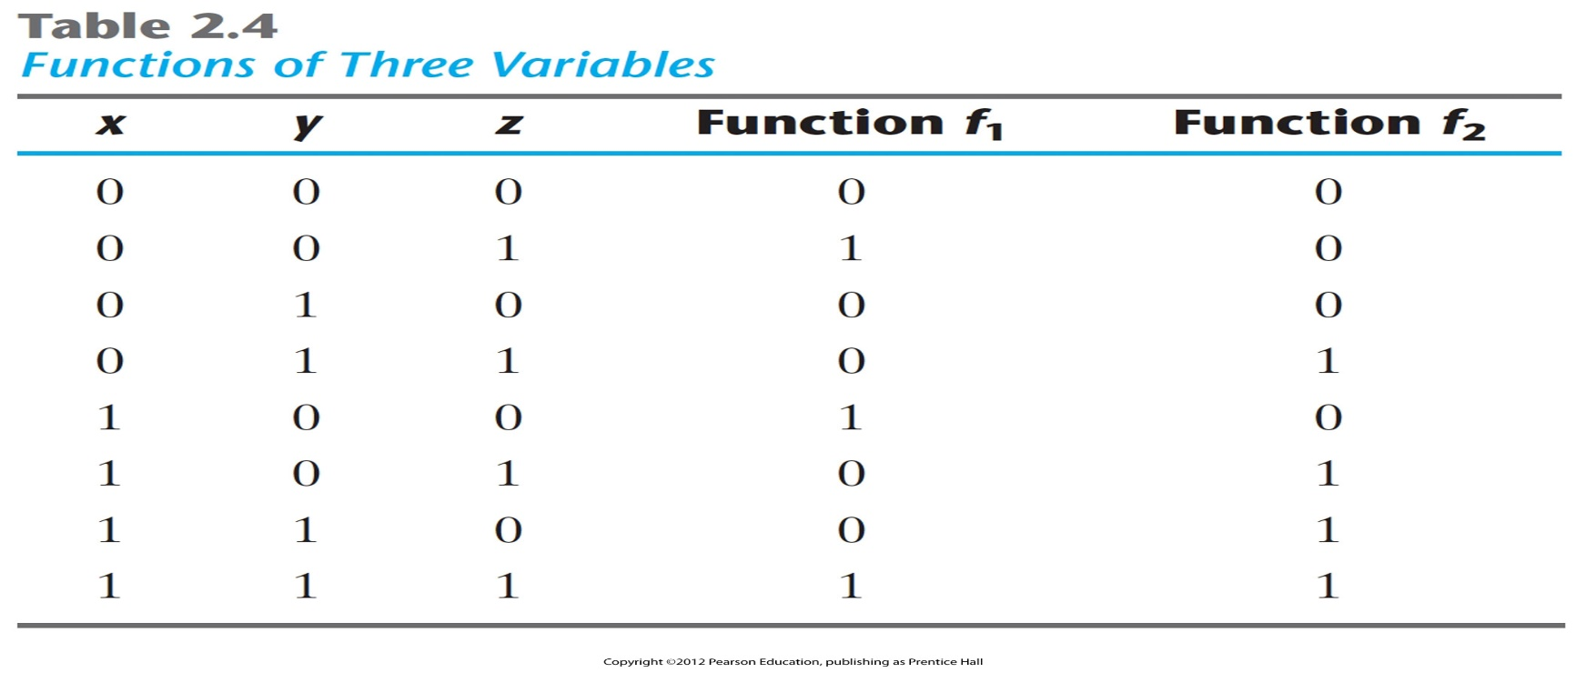
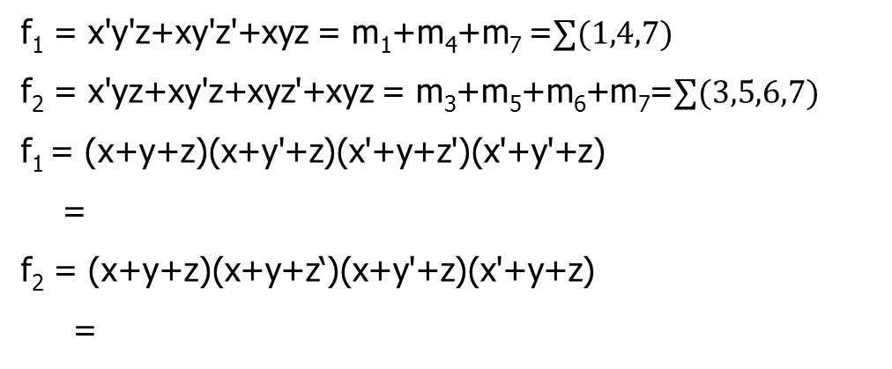
Example : minterm and maxterm

Slide 21
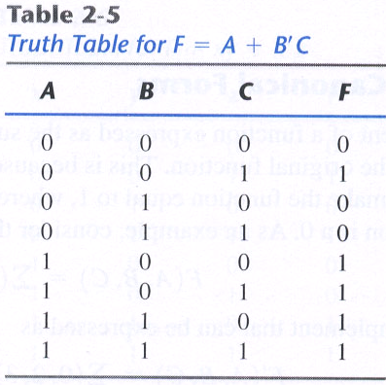
Example(cont.)
Sum of Minterms
Ex ) Express the Boolean function F=A+B'C in a sum of minterms.
A = A(B+B') = AB +AB'
= AB(C+C') + AB'(C+C')
= ABC + ABC' + AB'C +AB'C'
B'C = B'C(A+A') = AB'C + A'B'C
F = A + B'C
= A' B'C + AB'C' + AB'C + ABC' + ABC
= m₁ + m₄ + m₅ + m₆ + m₇
_{= ∑(1, 4, 5, 6, 7)}

Slide 22
Example(cont.)
Product of maxterms
Ex 2-5) Express the Boolean function F = xy + x'z in a product of maxterm form.
F = xy + x'z = (xy+x')(xy+z)
= (x+x')(y+x')(x+z)(y+z)
= (x'+y)(x+z)(y+z)
x' + y= x' + y + zz'= (x'+y+z)(x'+y+z')
x + z= x + z + yy'= (x+y+z)(x+y'+z)
y + z= y + z + xx'= (x+y+z)(x'+y+z)
F = (x+y+z)(x+y'+z)(x'+y+z)(x'+y+z')
= M₀M₂M₄M₅
F(x, y, z) = ∏(0, 2, 4, 5)

Slide 23
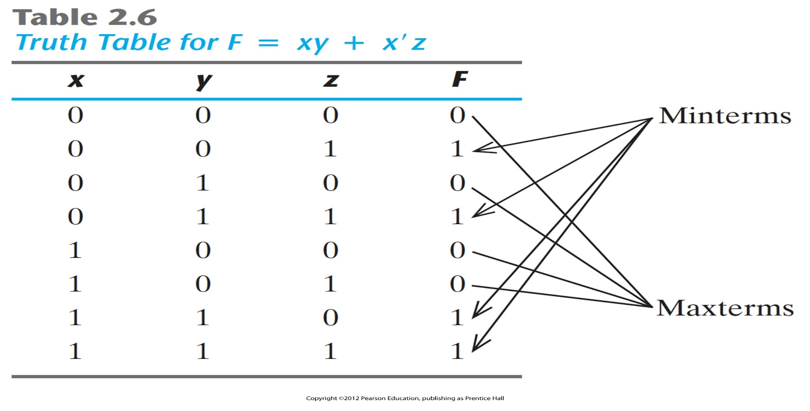
Example(cont.)
F(A,B,C) = ∑(1,4,5,6,7)
↓ complement (F값이 1이 아닌 값들)
F`(A,B,C) = ∑(0,2,3)
↓ complement (minterm <-> maxterm)
F(A,B,C) = ∏(0,2,3)
F(A,B,C) = ∑(1,4,5,6,7) = ∏(0,2,3)
F을 sum of minterms & product of maxterms으로
모두 표현가능
mj` = Mj
maxterm with subscript j is a complement of the
minterm with the same subscript j and vice versa
Ex) F = xy + x'z
F(x, y, z) = ∑(1, 3, 6, 7)
F(x, y, z) = ∏(0, 2, 4, 5)

Slide 24
Canonical Forms
The sum of minterms and the product of maxterms forms are known as the canonical forms of a function

Slide 25
Standard Forms
Sum of Products (SOP) and Product of Sums (POS) are also standard forms
AB+CD = (A+C)(B+C)(A+D)(B+D)
The sum of minterms is a special case of the SOP form, where all product terms are minterms
The product of maxterms is a special case of the POS form, where all sum terms are maxterms
create two-level structure of gates (two-level structure produces the least amount of delay through the gates when the signal propagates from the inputs to the outputs)

Slide 26
SOP and POS Conversion
SOP -> POS
F = AB + CD
= (AB+C)(AB+D)
= (A+C)(B+C)(AB+D)
= (A+C)(B+C)(A+D)(B+D)
POS -> SOP
F = (A’+B)(A’+C)(C+D)
= (A’+BC)(C+D)
= A’C+A’D+BCC+BCD
= A’C+A’D+BC+BCD
=A’C+A’D+BC

Slide 27
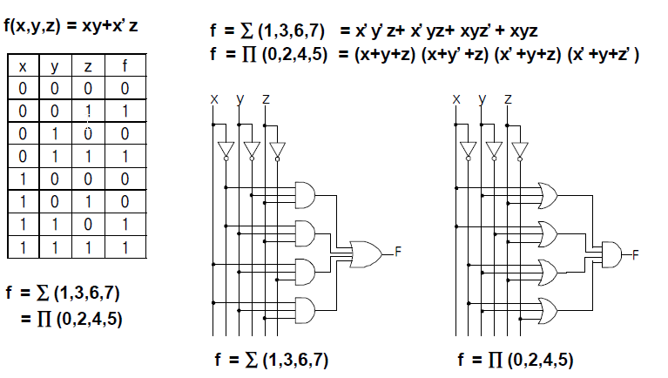
Canonical and Standard Forms
Sum of Minterm ⬄ Product of Maxterm

Slide 28
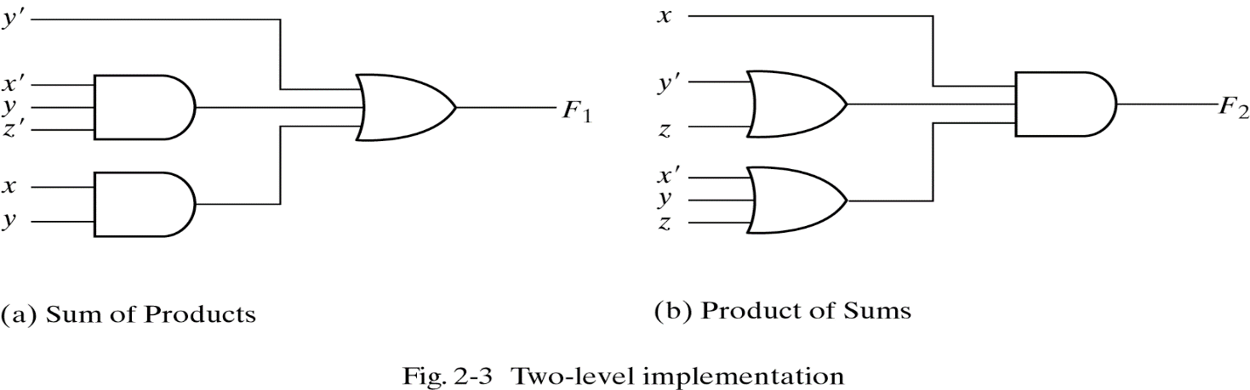
Standard Forms and Logic Circuit
Standard Forms
- Sum of product : F₁ = y' +xy + x'yz'
- Product of sum : F₂ = x(y'+z)(x'+y+z'+w)
Sum of products representation most common in industry.

Slide 29
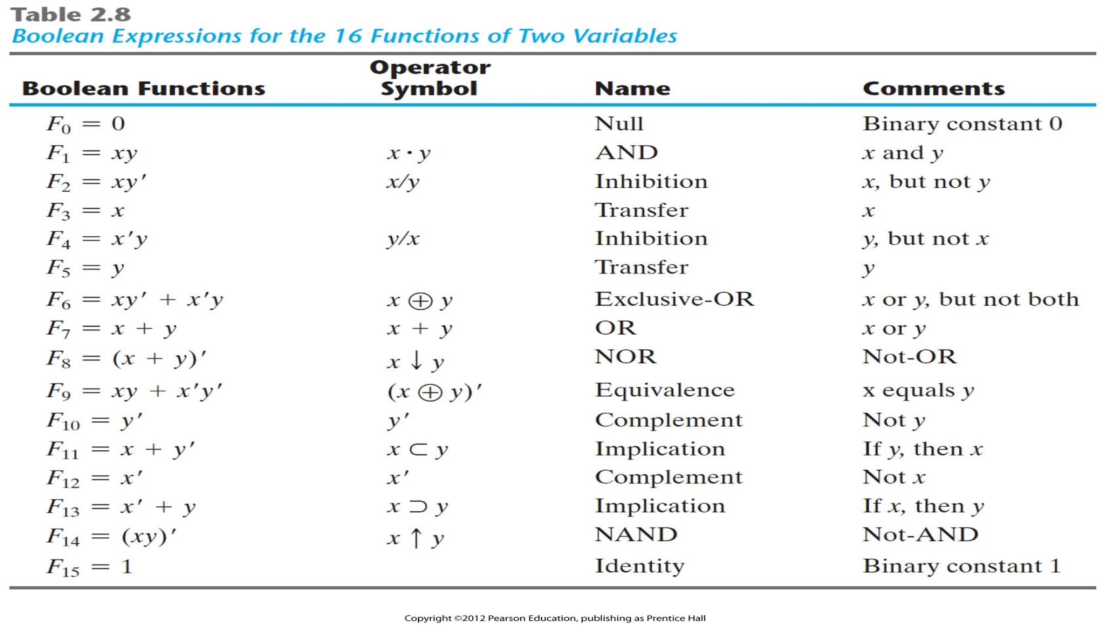
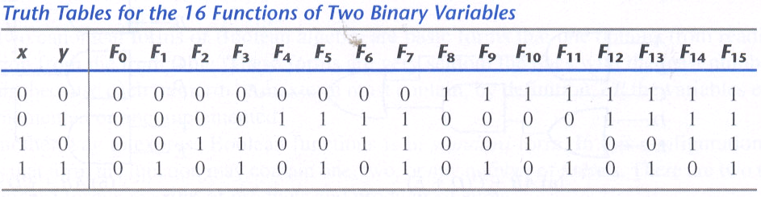
Other Logic Operations

Slide 30
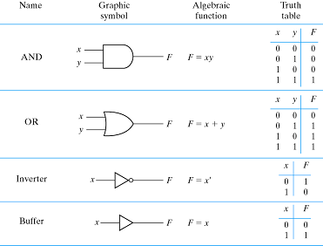
Digital Logic Gate

Slide 31
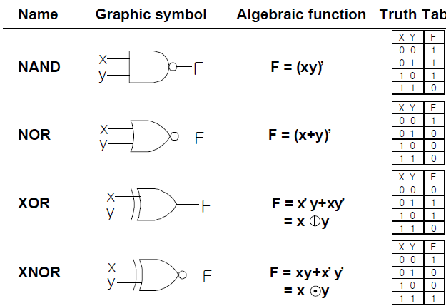
Digital Logic Gate
excludes the combination of
both x and y being equal to 1

Slide 32
Commutative/associative law
AND, OR, XOR, XNOR : both Commutative and associative law exist
NAND, NOR : only commutative law (should use the correct parentheses to signify the proper sequence of the gates)
the gate can be extended to have more than two inputs if the binary operation it represents is commutative and associative.
NAND, NOR – associative X → can’t be extended to have more than two input to overcome this difficulty
1. x↓y↓z (NOR) = (x+y+z)` (OR + complement)
2. x↑y↑z (NAND) = (xyz)` (AND + complement)
1,2을 이용해서 NOR, NAND의 multiple input을 표현한다.

Slide 33
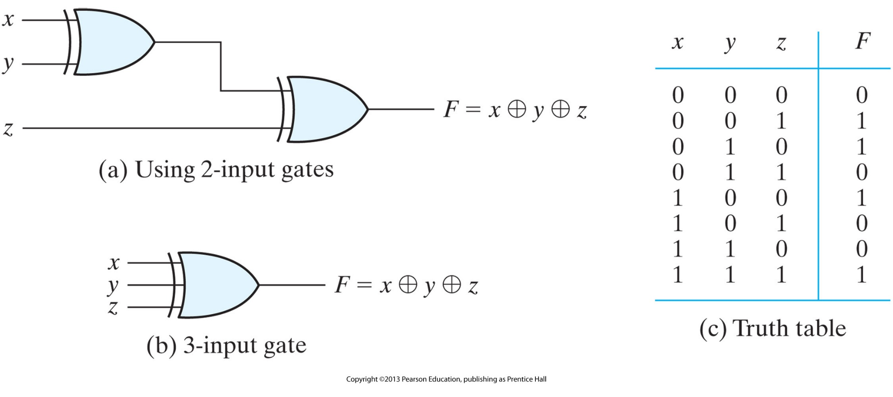
Digital Logic Gate
- exclusive-OR (XOR) :odd function

Slide 34
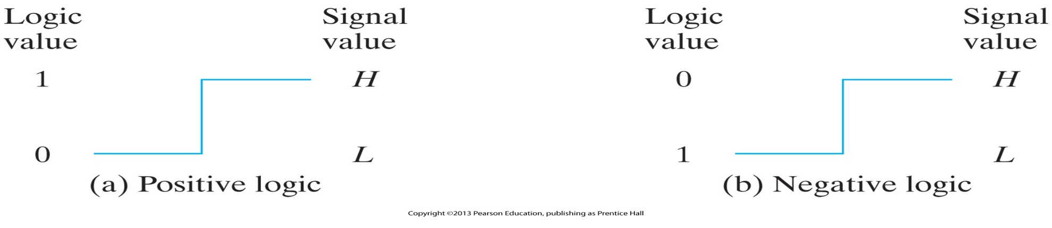
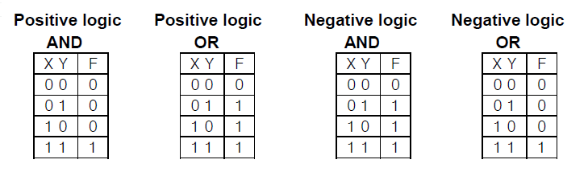
Digital Logic Gate
Positive and Negative Logic

